Slide 1
CSE 12 – Basic Data Structures and Object-Oriented Design Lecture 8
Greg Miranda & Paul Cao, Winter 2021
This lecture is being recorded

Slide 2
Announcements
Quiz 8 due Monday @ 8am
Survey 3 due tonight @ 11:59pm
PA3 due Wednesday @ 11:59pm
Exam 1 next Friday
Released @ 8am on Friday
Closes @ 10am on Saturday
More details to be released on Piazza soon

Slide 3

Topics
Stack
Runtime analysis

Slide 4
Stack
A stack is a data Structure in which insertion and deletion take place at the same end.
Stacks are known as LIFO (Last In, First Out) lists.
The last element inserted will be the first to be retrieved
We can only add/remove/examine the last element added (the "top").
push
Pop
top

Slide 5
Stack Operations
Push
To insert an item from Top of stack is called push operation.
POP
To put-off, get or remove some item from top of the stack is the pop operation.
Peek
Looks at the object at the top of this stack without removing it from the stack.
IsEmpty
Stack considered empty when there is no item on top. IsEmpty operation return true when there is no item in stack else false.
IsFull
Stack considered full if no other element can be inserted on top of the stack.
https://docs.oracle.com/javase/10/docs/api/java/util/Stack.html

Slide 6
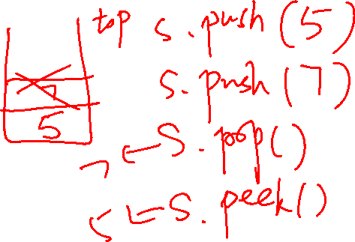
Basic Operation Explanation
Notes:
Draw on the screen
From an empty stack, push(5), then push(10)
Then peek()
Then pop()

Slide 7
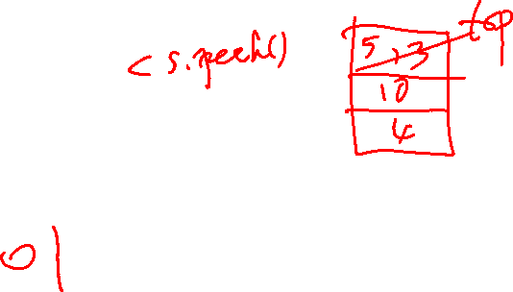
Stack
Consider doing the following operations on an initially empty stack, s:
s.push(4)
s.push(10)
s.push(13)
s.pop()
s.push(5)
What are the contents of the stack, from top (left) to bottom (right):
4, 10, 13, 5
B. 5, 13, 10, 4
C. 5, 10, 4
D. 5, 13, 10
E. other

Slide 8
Is a Stack an ADT or a data structure?
ADT
Data structure
I have no idea, what's the difference again??

Slide 9
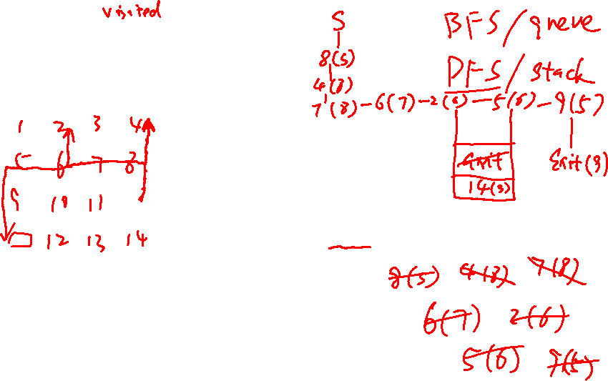
Searching with a Stack
col
col
col
col
0
1
2
3
SearchForTheExit
Initialize a Stack to hold Squares as we search
Mark starting square as visited
Put starting square on task list
While Stack is not empty
Remove square sq from task list
Mark sq as visited
If sq is the Exit, we're done!
For each of square's unseen neighbors (S, W, N, E):
Set neighbor's previous to sq
Add neighbor to Stack
row
0
row
1
row
S
2
row
Exit
3
Label the cells in the order in which they are visited by the algorithm.
What is the final path to the goal?

Slide 10
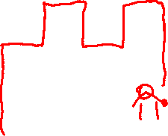
// Iterative DFS using stack
public void dfsUsingStack(Node node){
Stack<Node> stack=new Stack<Node>();
stack.add(node);
while (!stack.isEmpty()){
Node element=stack.pop();
if(!element.visited){
System.out.print(element.data + " ");
element.visited = true;
}
List<Node> neighbours=element.getNeighbours();
for (int i = 0; i < neighbours.size(); i++) {
Node n=neighbours.get(i);
if(n!=null && !n.visited){
stack.add(n);
}
}
}
}
col
col
col
col
0
1
2
3
row
0
row
1
row
S
2
row
Exit
3

Slide 11
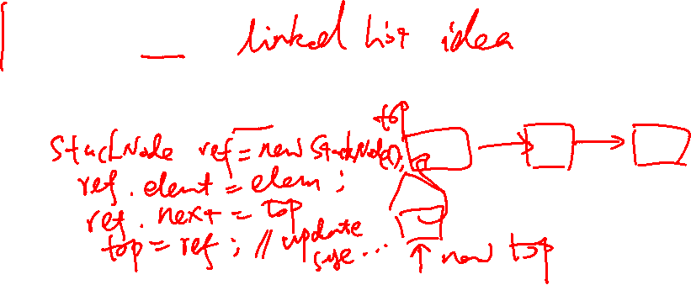
Stacks - Implementation
One option: Implement the methods in the ADT from scratch.
public class StackWorklist implements SearchWorklist{
protected class StackNode {
Square element;
StackNode next;
}
private StackNode top;
public void add( Square elem ) {
}
}

Slide 12

Stacks - Implementation
One option: Implement the methods in the ADT from scratch.
public class myStack<E> {
protected class StackNode {
E element;
StackNode next;
}
private StackNode top;
public boolean push( E elem ) {
StackNode n = new StackNode();
n.next = top;
n.element = elem;
top = n;
return true;
}
}
public class myList<E> {
protected class ListNode {
E element;
ListNode next;
}
private ListNode head;
public boolean addFirst( E elem ) {
ListNode n = new ListNode();
n.next = head;
n.element = elem;
head = n;
return true;
}
}
Why redo all this work??

Slide 13
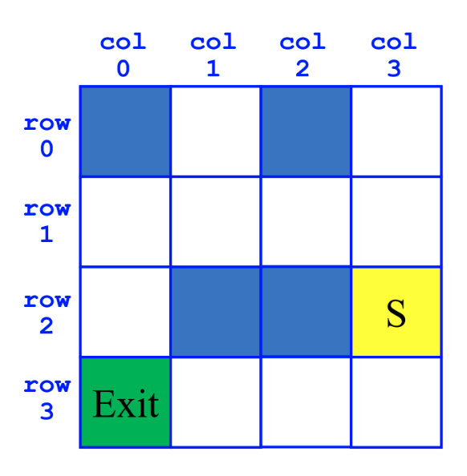
Breadth-First Search (BFS)
SearchForTheExit
Initialize a Queue to hold Squares as we search
Mark starting square as visited
Enqueue starting square on Queue
While Queue is not empty
Dequeue square sq from Queue
Mark sq as visited
If sq is the Exit, we're done!
For each of square's unvisited neighbors (S, W, N, E):
Set neighbor's previous to sq
Enqueue neighbor to Queue

Slide 14
Depth-First Search (DFS)
SearchForTheExit
Initialize a Stack to hold Squares as we search
Mark starting square as visited
Push starting square on Stack
While Stack is not empty
Pop square sq from Stack
Mark sq as visited
If sq is the Exit, we're done!
For each of square's unvisited neighbors (S, W, N, E):
Set neighbor's previous to sq
Push neighbor to Stack

Slide 15
How to compare ideas in computing
Bench mark
code things up and run it
Eg. implement priority queue with
sorted array
sorted linked list
unsorted linked list
heap
Pro and con of this approach?

Slide 16
Lists: One application
List<Songs> playlist
Uptown funk
Shake It Off
All About that Bass
Shut Up and Dance
Thinking Out Loud
…

Slide 17

Lists: One application
List<Songs> playlist
Uptown funk
Shake It Off
All About that Bass
Shut Up and Dance
Thinking Out Loud
…
Imagine that this list is implemented as an array and that there are currently 20 songs in my playlist.
How many places do I have to look to determine whether “All About that Bass” is in my playlist?
1
3
10
20
Other

Slide 18
Lists: Running time
List<Songs> playlist
???
???
???
???
???
…
Imagine that this list is implemented as an array and that there are currently 20 songs in my playlist, but now you can’t see what any of them are.
How many places do I have to look to determine whether “Riptide” is in my playlist in the BEST case?
1
10
15
20
Other

Slide 19

Lists: Running time
List<Songs> playlist
???
???
???
???
???
…
Imagine that this list is implemented as an array and that there are currently 20 songs in my playlist, but now you can’t see what any of them are.
How many places do I have to look to determine whether “Riptide” is in my playlist in the WORST case?
1
10
15
20
Other

Slide 20
Running time: What version of the problem are you analyzing
One part of figuring out how long a program takes to run is figuring out how “lucky” you got in your input.
You might get lucky (best case), and require the least amount of time possible
You might get unlucky (worst case) and require the most amount of time possible
Or you might want to know “on average” (average case) if you are neither lucky or unlucky, how long does an algorithm take.
Almost always, what we care about is the WORST CASE or the AVERAGE CASE. Best case is usually not that interesting, unless we can prove it's slow!
In CSE 12 when we do analysis, we are doing WORST CASE analysis unless otherwise specified.

Slide 21
Optional Application of Stack

Slide 22
Expression Evaluation Using Stack
Given an algebraic expression, evaluate its value
12*(5 + 2) – 12/4 + 11%3
Assume: only has binary operator (+, - , *, /, %)
Input: an algebraic expression and order of precedence on operators
Output: the value of the expression

Slide 23
Infix vs Postfix
If a mathematical expression is written as operand1 operator operand2, then it is in the infix format
4 + 5
If an expression is written as operand1 operand2 operator, then it is in the postfix format
4 5 +
12*(5 + 2) – 12/4 + 11%3
infix format

Slide 24
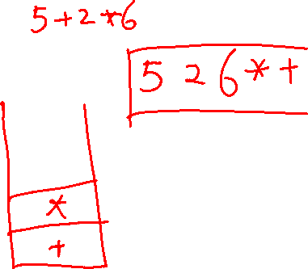
Infix to Postfix algorithm
Initial expression: Q Final expression P
Start with an empty stack. We scan Q from left to right.
A. While (we have not reached the end of Q)
1. If (an operand is found) Add it to P
2. If (a left paren is found) Push it onto the stack
3. If (a right paren is found)
While (the stack is not empty AND no matching paren is on top)
Pop the stack and add the popped value to P
Pop the left parenthesis from the stack and discard it
4. If (an operator is found)
If (the stack is empty or if the top element is a left paren)
Push the operator onto the stack
Else
While (the stack is not empty AND the top of the stack is not a left paren
AND precendece operator <= precedence of the top of the stack)
Pop the stack and add the top value to P
Push the latest operator onto the stack
B. While (the stack is not empty) Pop the stack and add the popped value to P
Notes:
Normal process we expect to see
left paren or operand on the left
operator
right paren or operand on the right
There is a precedence of operators so we have to operate on the operator with higher precedence
paren
*, /, %
+, -

Slide 25
Start with an empty stack. We scan Q from left to right.
A. While (we have not reached the end of Q)
1. If (an operand is found) Add it to P
2. If (a left paren is found) Push it onto the stack
3. If (a right paren is found)
While (the stack is not empty AND no matching paren is on top)
Pop the stack and add the popped value to P
Pop the left parenthesis from the stack and discard it
4. If (an operator is found)
If (the stack is empty or if the top element is a left paren)
Push the operator onto the stack
Else
While (the stack is not empty AND the top of the stack is not a left paren
AND precendece operator <= precedence of the top of the stack)
Pop the stack and add the top value to P
Push the latest operator onto the stack
B. While (the stack is not empty) Pop the stack and add the popped value to P
Convert 5 + 3 * (6 / 2 + 4)
Notes:
result is 5 3 6 2 / 4 + * +

Slide 26
Start with an empty stack. We scan Q from left to right.
A. While (we have not reached the end of Q)
1. If (an operand is found) Add it to P
2. If (a left paren is found) Push it onto the stack
3. If (a right paren is found)
While (the stack is not empty AND no matching paren is on top)
Pop the stack and add the popped value to P
Pop the left parenthesis from the stack and discard it
4. If (an operator is found)
If (the stack is empty or if the top element is a left paren)
Push the operator onto the stack
Else
While (the stack is not empty AND the top of the stack is not a left paren
AND precendece operator <= precedence of the top of the stack)
Pop the stack and add the top value to P
Push the latest operator onto the stack
B. While (the stack is not empty) Pop the stack and add the popped value to P
3+2+5
3 2 5 + +
3 2 + 5 +
3 + 2 5 +
5 2 3 + +
Something else
Notes:
B

Slide 27
Start with an empty stack. We scan Q from left to right.
A. While (we have not reached the end of Q)
1. If (an operand is found) Add it to P
2. If (a left paren is found) Push it onto the stack
3. If (a right paren is found)
While (the stack is not empty AND no matching paren is on top)
Pop the stack and add the popped value to P
Pop the left parenthesis from the stack and discard it
4. If (an operator is found)
If (the stack is empty or if the top element is a left paren)
Push the operator onto the stack
Else
While (the stack is not empty AND the top of the stack is not a left paren
AND precendece operator <= precedence of the top of the stack)
Pop the stack and add the top value to P
Push the latest operator onto the stack
B. While (the stack is not empty) Pop the stack and add the popped value to P
3+2+5*(4-12)+6%2
3 2 + 5 4 12 - * + 6 2 % +
3 2 + + 5 4 12 - * + 6 2 %
3 2 5 + 4 12 - + 6 2 % +
3 2 5 + + 4 12 + - 6 2 %
Something else
Notes:
A

Slide 28
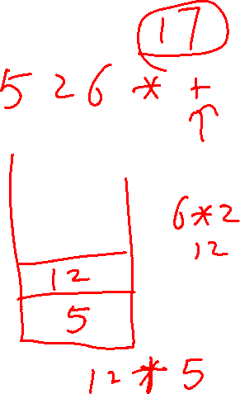
Postfix to evaluation
Start with an empty stack. We scan P from left to right.
While (we have not reached the end of P)
If an operand is found
push it onto the stack
If an operator is found
Pop the stack and call the value A
Pop the stack and call the value B
Evaluate B op A using the operator just found.
Push the resulting value onto the stack
Pop the stack (this is the final value)

Slide 29
Start with an empty stack. We scan P from left to right.
While (we have not reached the end of P)
If an operand is found
push it onto the stack
If an operator is found
Pop the stack and call the value A
Pop the stack and call the value B
Evaluate B op A using the operator just found.
Push the resulting value onto the stack
Pop the stack (this is the final value)
Evaluate 5 3 6 2 / 4 + * +

